Slide 1

Final project
Bank Fraud Detection
Dhinesh Aaditya R C, Joby J, Karthikeyan J, Nishandhine U, Varshini A S

Slide 2
Introduction
Bank fraud is a criminal act that involves stealing money or property from a bank through fraudulent means. Detecting and preventing bank fraud is crucial for financial institutions as it helps to maintain the trust of their customers, protect their assets, and ensure the stability of the financial system.

Slide 3
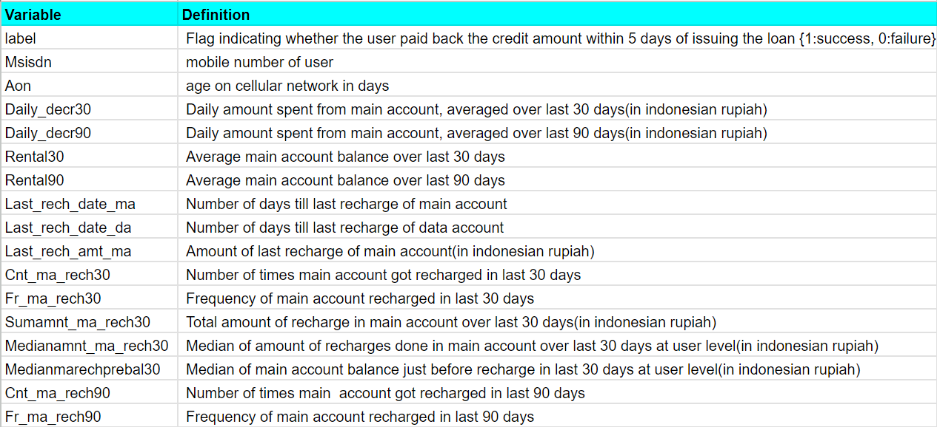
Data description

Slide 4
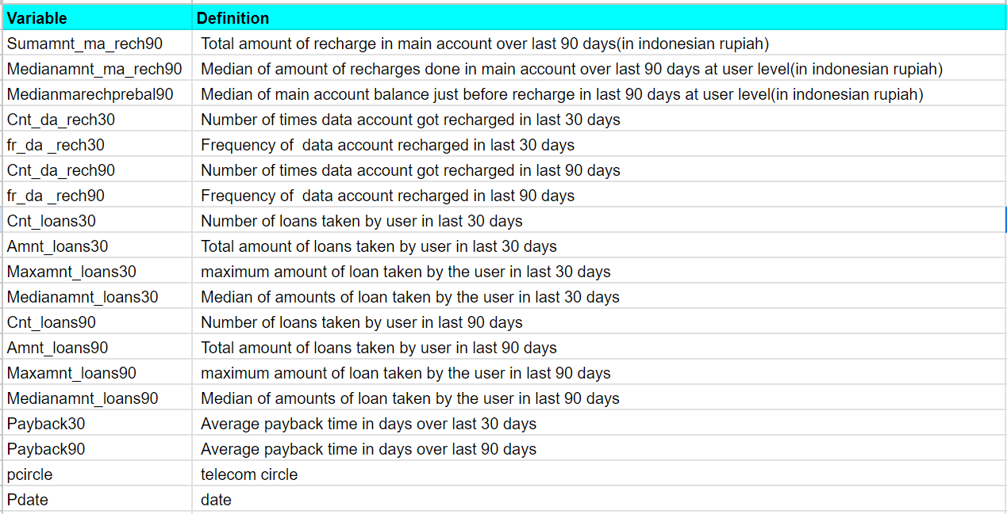
Data description

Slide 5
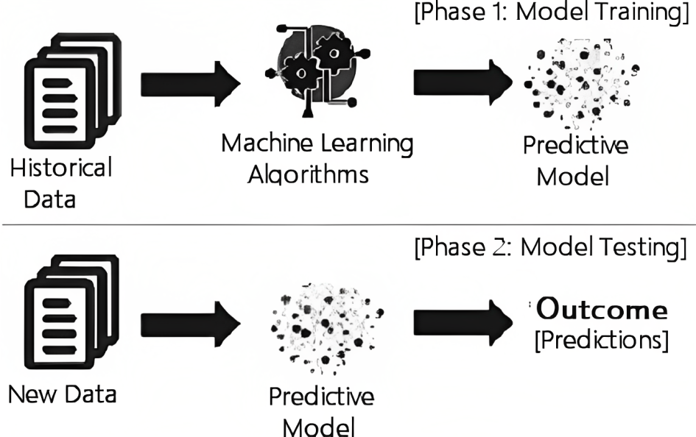
Approach

Slide 6
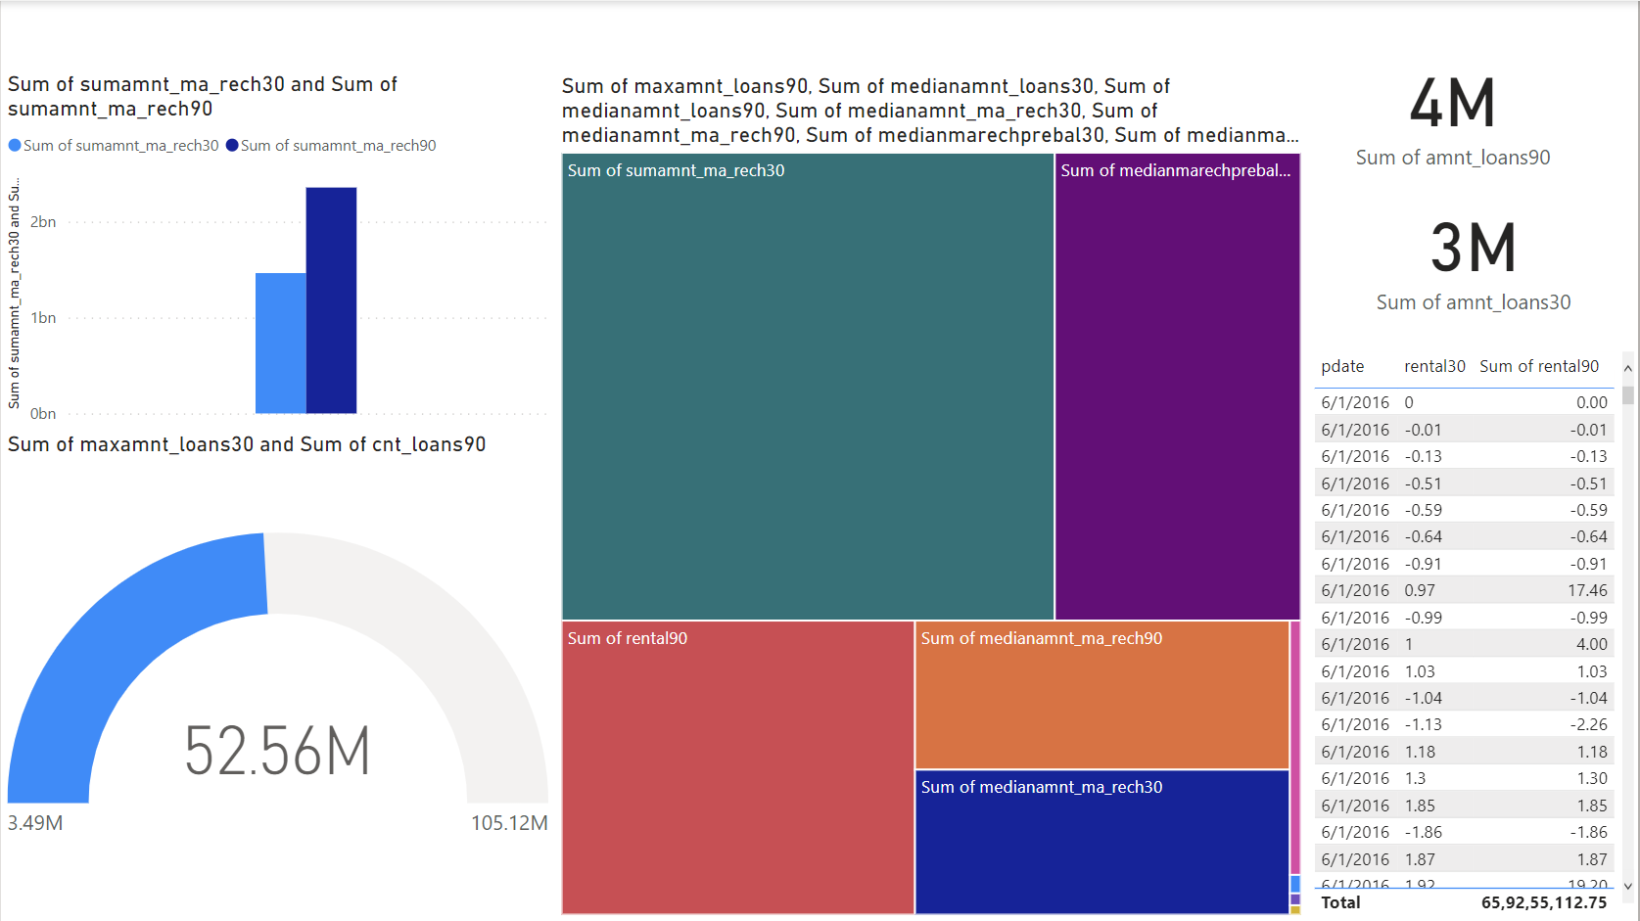
Visualization

Slide 7
Algorithms
We used the following algorithms in our project
KNeighborsClassifier
AdaBoost Classifier
Random Forest Classifier
Naive Bayes

Slide 8
91.47% 95.45%
88.81% 93.84%
90.88% 95.00%
59.75% 70.94%
Performance
RandomForestClassifier
Accuracy Score
F1 Score
KNeighborsClassifier
AdaBoostClassifier
Naive Bayes
Accuracy Score
F1 Score
Accuracy Score
F1 Score
Accuracy Score
F1 Score
By our observation RandomForestClassifier had the best performance

Slide 9
Conclusion
Algorithms used in machine learning are created in such a way that they attempt to learn on their own using prior knowledge. The algorithms can react and respond to circumstances for which they are not expressly programmed after learning from prior experience. Therefore, machine learning algorithms are very helpful in the discovery of fraud. It attempts to find obscure trends that aid in uncovering previously undetected fraud.
We can draw the conclusion that in this labeled dataset, fraud detection in financial transactions is effective, and the best algorithm for this purpose is Random Forest.

Slide 10
Thank you !

